Slide 1
Training on the Participatory Planning Approach for Equitable Mass Administration of Medicine (MAM) to tackle Neglected Tropical Diseases (NTD) in Nigeria
June, 2021

Slide 2
Objectives of scale up training
Identify and develop participatory non-hierarchical skills to enhance equitable input of all partners in planning for MAM, including the promotion of joint solution development and decision making from community level implementers.
Acquire and transfer participatory facilitation and teaching skills for cascading training and engaging with a range of stakeholders.

Slide 3
Objectives of scale up training continued.
Learn and share participatory tools that will help to engage communities in planning and to take ownership of MAM so that more people are reached.
Introduce and empower participants to engage with the PGP, learning packs and supporting video.

Slide 4
Focus of training for days 1 and 2
Development of participatory skills for the NTD program
Capacity strengthening of facilitatory skills.
Transfer of Facilitatory skills.
Introduction of Tools
Going through the PGP modules alongside the corresponding video sections
Developing action Plan
Developing an action plan for MAM

Slide 5

Day 1: Part A
Development of participatory skills

Slide 6
1.3 Power Exercise
Write on the paper any title you are known by
Dr, Mr, Mrs, LNTD, SNTD, PHC Director
Read it out and throw it in the basket

Slide 7
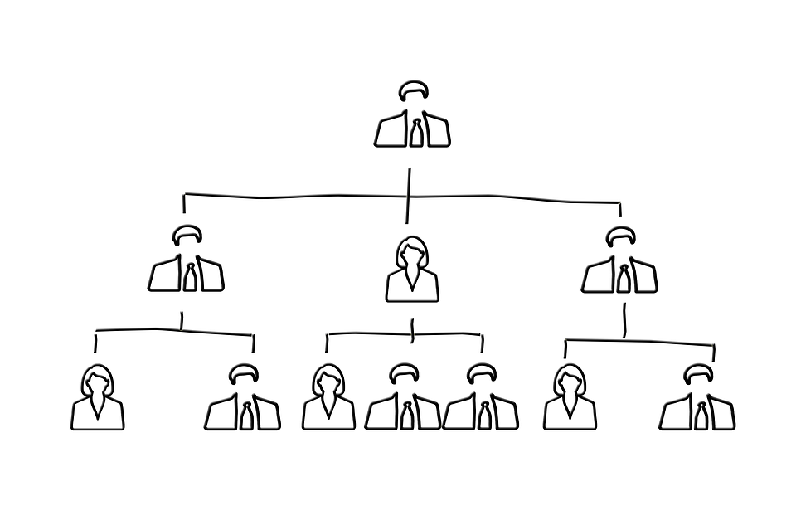
Minimising power in a group
Power can be a block to really identifying contextual solutions as people who feel their knowledge is not valued will not contribute.
Therefore, it is important to make the point that we have tried to remove hierarchy and titles for this training session so that everyone should feel able to participate equally.

Slide 8
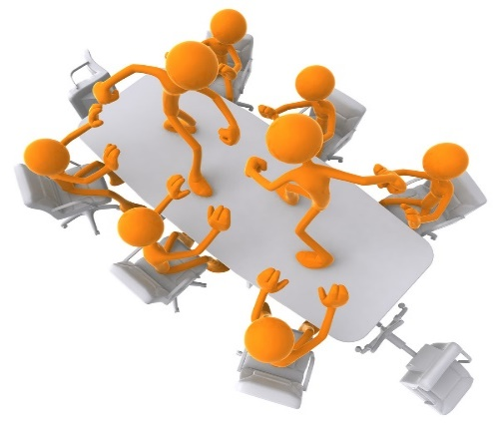
Facilitator Personal Attributes
Session 2.0

Slide 9

Aim of session
The aim of this session is to:
Understand how various personal attributes contribute towards successful work with the community, FLHF staff and other local level stakeholders.
Strengthen facilitatory skills that can be cascaded to other implementers
Understand the importance of trust, respect and mutuality in facilitation

Slide 10

Activity 2.1
What is trust, respect and mutuality?

Slide 11

Trust, Respect and Mutuality
Trust: Belief or confidence in the reliability of someone or something
Respect: Due regard to someone’s feeling or rights of others
Mutuality: Sharing and accommodating of feelings and action in a relationship or group.

Slide 12

Activity 2.2
What skills support good communication?

Slide 13
Skills for building trust and respect
Free and open communication: Implementers and beneficiaries should feel safe bringing new ideas, concerns or criticism.
Consistency: Always keep to your words and apologise where change becomes unavoidable.

Slide 14
Skills for building trust and respect
Action: Trust and respect can easily be earned when we implement decisions that are agreed. Failure to implement agreed decisions reduces trust and respect.
Confidence: You are easily trusted and respected when you demonstrate confidence in yourself. Those following will doubt your expertise when you demonstrate uncertainty, this should not be confused with unteachability and openness to learn.

Slide 15

Communication and facilitation skills
What skills do I need?
To work effectively with partners in developing new implementation plans, you will need to explore and practice some essential communication and facilitation skills. These include
    Neutrality
    Good body language
    Good questioning skills and
    Good facilitation skills

Slide 16
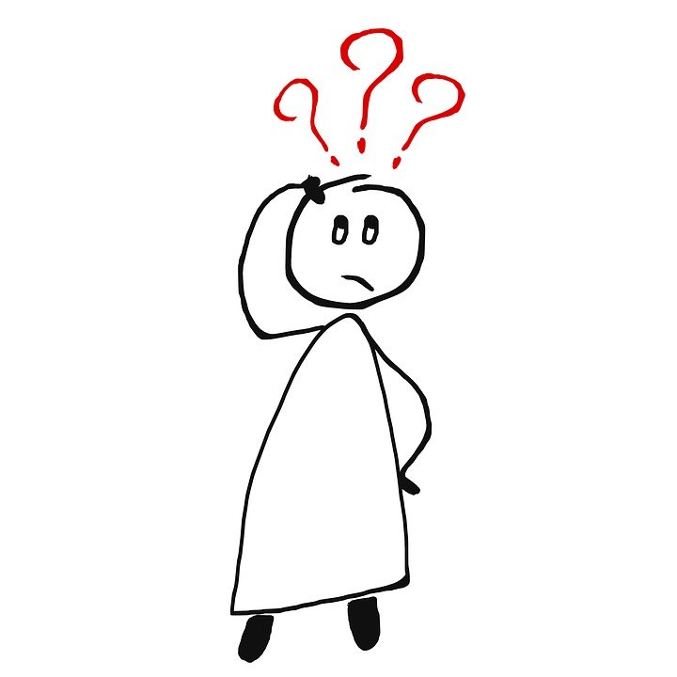
Why is it important to be neutral?
  The way you ask questions will influence
  the answers you get. As you are interested in the NTD program, do not influence their answers by asking leading questions.
  Example of a leading question:
  “This is an excellent way to distribute medicines, don’t you think?”

Slide 17

What are good communication and facilitation skills?
As part of your work in the NTD programme you will need to facilitate many meetings with various stakeholders.
Here are some ideas which will help you become a better facilitator:
  Use open-ended questions to stimulate discussion
  Follow-up ideas with probing questions
  Stop anyone from dominating
  Encourage participation by all members

Slide 18


What are good facilitation skills?
  Guide the meeting towards its goal
  Keep the meeting moving to maintain participants’ interest.
  Take breaks when people are tired
  Respect local customs and etiquette
  Summarise the result of the discussion
  Use cards to help organize ideas
  Maintain neutrality
  Anticipate what might happen and be prepared.
  Encourage those who are quiet to speak.

Slide 19

Why is it important to use good body language?
  Your body language also influences community members’ answers.
  Show that you value their opinions through open body language.

Slide 20

Disengaged body language
If someone is exhibiting one or more of the following behaviors, they'll likely be disengaged, disinterested or unhappy:
Arms folded in front of the body.
Minimal or tense facial expression.
Body turned away from you.
Eyes downcast, maintaining little contact
https://www.mindtools.com/pages/article/Body_Language.htm

Slide 21
Effective body language
Positive body language can help you to engage people, mask any presentation nerves , and project confidence when you speak in public. Here are a few tips to help you do this:
Have a positive posture
Sit or stand upright, with your shoulders back and your arms unfolded by your sides or in front of you
Don't be tempted to put your hands in your pockets, or to slouch, as this will make you look disinterested.
Keep your head up. Your head should be upright and level Leaning too far forward or backward can make you look aggressive or arrogant.
Use open hand gestures. Spread your hands apart, in front of you, with your palms facing slightly toward your audience. This indicates a willingness to communicate and share ideas Keep your upper arms close to your body. Take care to avoid overexpression, or people may focus more on your hands than your ideas.

Slide 22

What type of questions should I use?
  Try to use open-ended questions and
  follow these up with probing questions.
  Open-ended questions invite stakeholders to reply freely and openly. Probing questions help you gain more insight into the participants’ answers.

Slide 23
Examples of open-ended and probing questions
What do you think about this mode of distribution?” (O)
  ….I like this system the best.
  Why do you prefer this mode of distribution better than the others? (P)
  ….Well, it will reach everyone in the community.
  Why is that important? (P)
  ….it will make more people feel better and stop the diseases from getting to other people.
  Is there anything else you like about this mode of distribution?” (O)
  ….If it is done in the right way, our communities will be more healthy than it used to be”

Slide 24
Conflict Resolutions and Power Dynamics
Session 3.0

Slide 25
Aim of session
To identify potential sources of conflicts, power structure in teams and utilize participatory means for resolution and see how this helps the program. Participants should be able to step down this training to other NTD implementers.

Slide 26
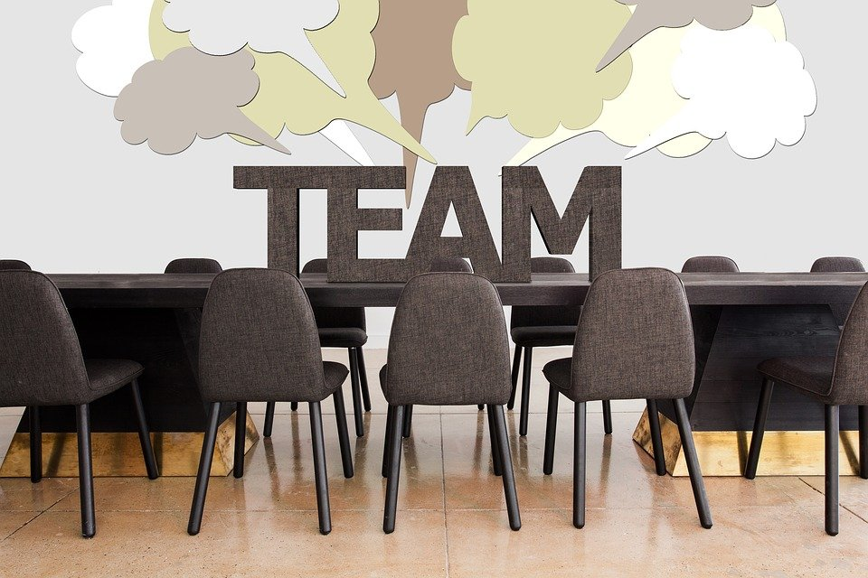
Activity 3.1- Resolving disagreements
Participants to share experience using skills previously learnt.

Slide 27
Conflict management strategy
Compromise
Dominating
Integrating
Avoiding
Accommodating
High
Concern for self
Low
Low
High
Concern for others

Slide 28

Conflict management strategies
Strategy One- Accommodating:
The accommodating strategy essentially entails giving the opposing side what it wants. The use of accommodation often occurs when one of the parties wishes to keep the peace or perceives the issue as minor.

Slide 29

Conflict management strategies
Strategy Two- Avoiding
The avoiding strategy seeks to put off conflict indefinitely. By delaying or ignoring the conflict, the avoider hopes the problem resolves itself without a confrontation. Those who actively avoid conflict frequently have low esteem or hold a position of low power.

Slide 30

Conflict management strategies
Strategy Three- Integrating
Collaboration works by integrating ideas set out by multiple people. The object is to find a creative solution acceptable to everyone. Collaboration, though useful, calls for a significant time commitment not appropriate to all conflicts.

Slide 31

Conflict management strategies
Strategy Four- Compromising
The compromising strategy typically calls for both sides of a conflict to give up elements of their position in order to establish a middle ground. This strategy prevails most often in conflicts where the parties hold approximately equivalent power.

Slide 32

Conflict management strategies
Strategy Five- Competing/dominating
Competition operates as a zero-sum game, in which one side wins and other loses. Highly assertive personalities often fall back on competition as a conflict management strategy.

Slide 33
Power dynamics
A "power dynamic" is the way different people or different groups of people interact with each other and where one of these sides is more powerful than the other one. ...
In social science and politics, power is the ability to influence or outright control the behaviour of people.

Slide 34
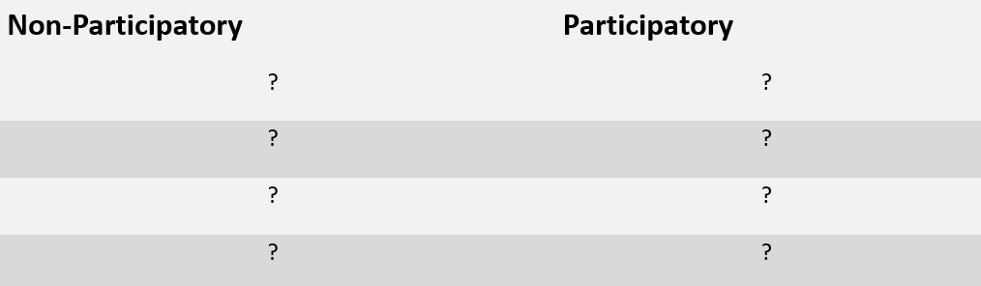
Activity 3.3
Participatory approach

Slide 35
Participatory approach
Non-Participatory | Participatory
Rigidity | Flexibility
Not listening to others | Good listener
Judgemental | Not judgemental
Not respecting others | Deeply respectful
Ignoring those who don’t speak | Being inclusive

Slide 36
Introduction to participatory tools
Day 1: Part B

Slide 37
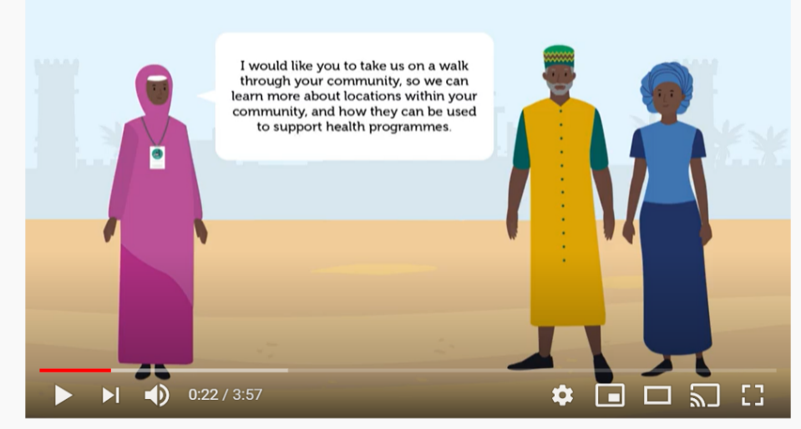
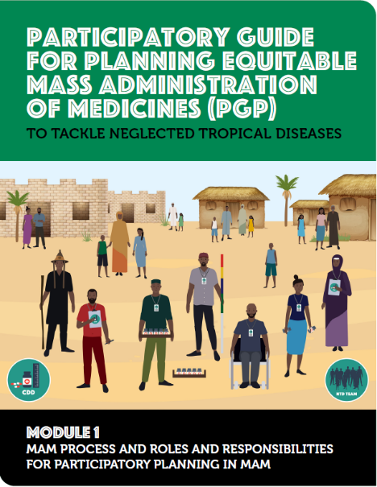
Introduction to PGP and video
The Participatory Guide for Planning (PGP) was developed as an evidenced based document from the COUNTDOWN study.
The video provides a visual guide to participatory planning and implementation of mass administration of medicines (MAM) for Neglected Tropical diseases.
It is expected that the video will be used together with the PGP.

Slide 38
Module 1: Roles and responsibilities
Session 5.0

Slide 39

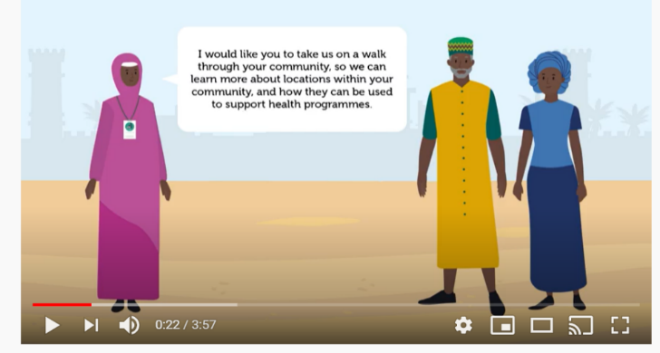
Module 1: Roles and Responsibilities
Play module one video
Discuss PGP module one (refer to page 7-10)
Question and answers

Slide 40
Module 2A:Stakeholder and community engagement
Session 6.0

Slide 41
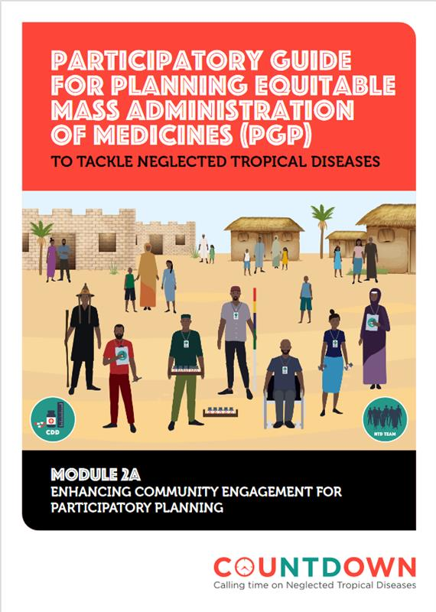

Stakeholder and community engagement
Play module two video
Discuss PGP module 2a (refer to pages 7-11)
Question and answers

Slide 42
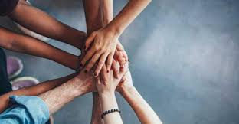
Community engagement
A meaningful and respectful involvement of community members in one or more aspects of planning for NTD programme(s) with the aim of harnessing their views and perceptions towards ensuring equitable coverage for MAM in their domain.
People to engage may include;
Traditional/ community leaders
Women and youth groups
People With Disabilities (PWD)
Migrant groups like the Fulani etc.
When to engage;
Planning
Sensitisation
Selection of CDDs
Deciding spots to administer medicines

Slide 43
Why engage?
Many community members of different ages suggested that if the village heads, community leaders, religious leaders or the chairperson of the community development association were involved in planning for MAM, it will increase acceptability and accessibility by reaching all members within that community.
Preferred dates for activities
Where to find certain group of persons in the community
Who to involve in different aspects of the programme

Slide 44
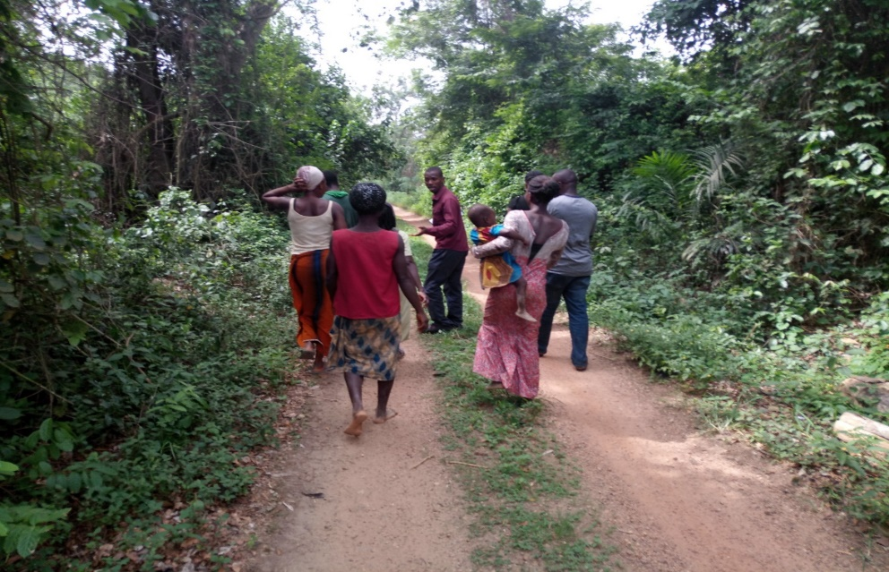
6.3a Methods of engaging: Transect Walk
An interactive walk through major routes within a community to identify structures that are/ can be used for various MAM processes E.g.
Places suitable for;
Sensitisation & mobilisation
Distribution of medicines
Identifying PWDs, women/ men, migrants in the community

Slide 45
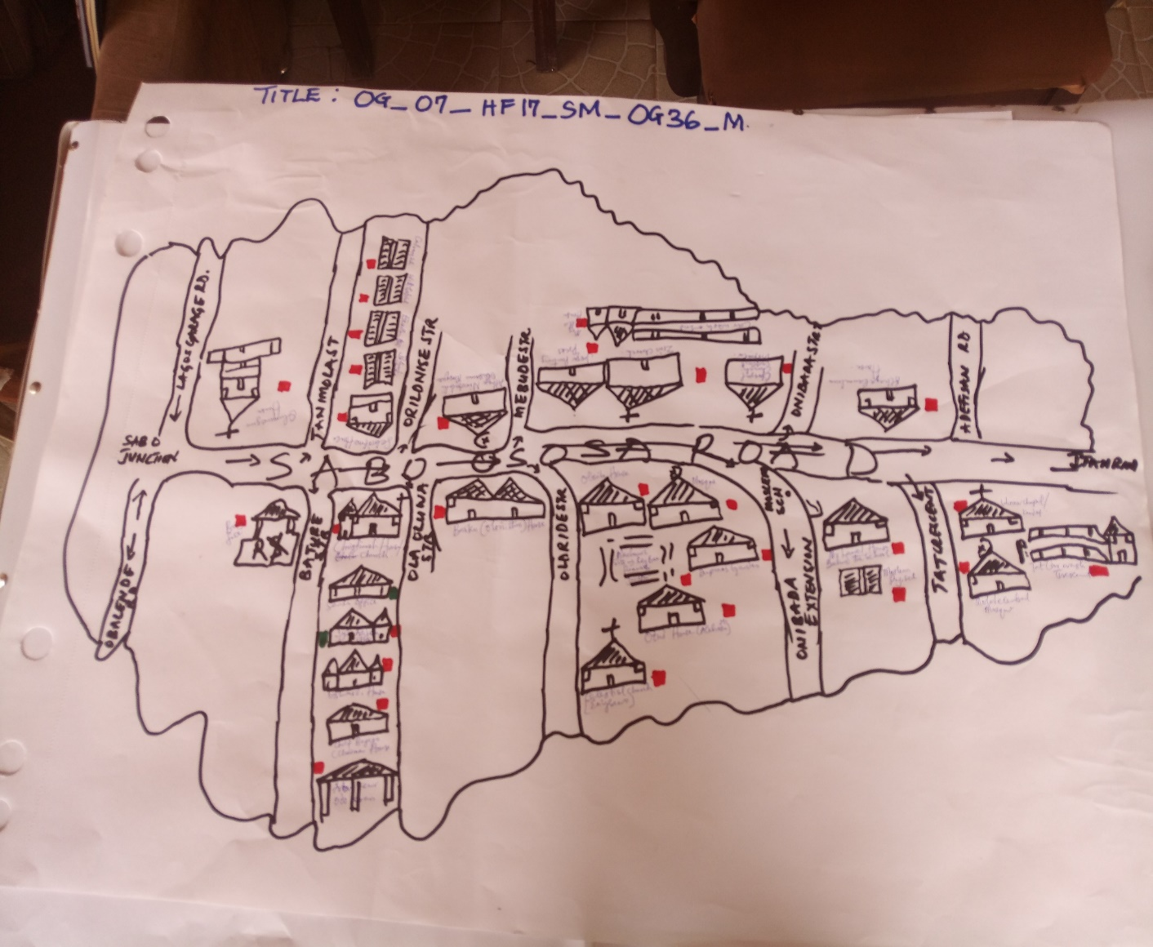
6.3b Methods of engaging: Social mapping
Drawing/sketching of a community layout to locate various points where different groupings and population are mostly found to be interacted with e.g.
Places where;
Young boys play soccer
Young girls fetch water
Women gather to hold meetings
Adult men hold meetings

Slide 46
Facilitatory methods to support dialogue with communities (Module 2A annex)
Session 7.0

Slide 47
Facilitatory methods to support dialogue with communities
Qualitative methods are used:
To obtain in-depth and contextual information about an individual’s experiences, beliefs, perceptions, motivations or values
To explore reasons, opinions and attitudes behind respondents’ answers through asking probing questions to gain a deeper understanding/ more information and explanation.

Slide 48
Examples of facilitatory methods
In-depth interview: An intensive qualitative interview with an individual to explore personal views, opinions or perspective on a subject matter.
Focused Group Discussion(FGD): An explorative discussion on a specific interest among a group of people. Individuals are allowed and encouraged to share their perception, ideas or opinions.
Problem Tree Analysis(PTA): This is also called situational analysis; it is aimed at finding solution by using a tree anatomy as an analogy. The root is referred to as causes, the trunk as problem and the leaves as consequences

Slide 49
Activity 7.2 Small group practice
Option 1: Interview
Option 2: Focus Group Discussion
Read PGP 2A annex
One person interviewer
One person interviewee
One person observer
Use topic guide in PGP
Rotate so everyone in each group can have an opportunity to practice
Read PGP 2A annex
In groups of 6-8
One person facilitator
Others are participants
Use the topic guide in PGP

Slide 50

Any Questions?

